Slide 1



Noida Institute of Engineering and Technology, Greater Noida
Conflict and Stress Management
Unit: III
Conflict and Stress Management
Deepika Sharma
Assistant Professor
MBA Dept
Course Details (MCA INT 5th Sem)

Slide 2

Faculty Introduction
Faculty Name: Deepika Sharma
Designation: Assistant Professor
Department: MBA
Email ID: deepika@niet.co.in
Qualification: Pursuing Ph.D.
Specialization: HR, Marketing
Teaching Area:
Total Experience: 2 Years

Slide 3
Evaluation Scheme

Slide 4
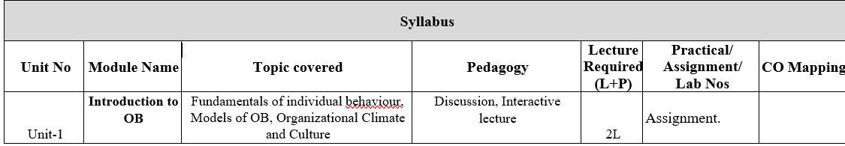
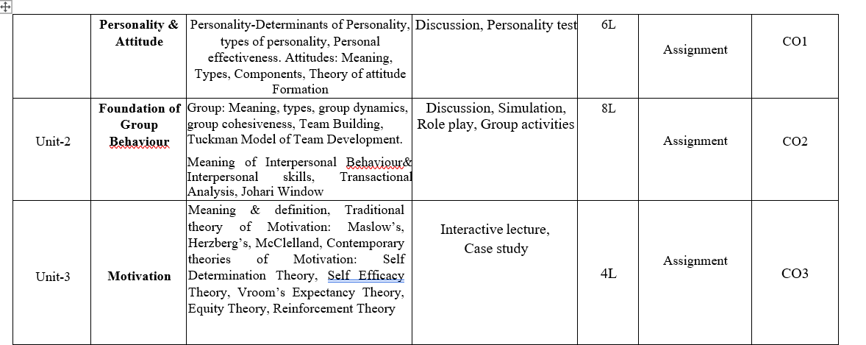
Syllabus

Slide 5
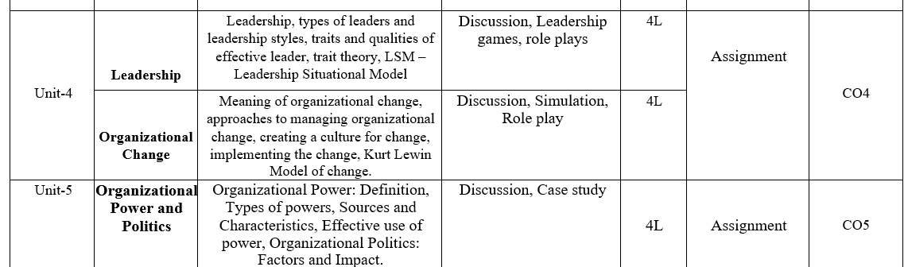
Syllabus

Slide 6
Branch Wise Applications
Being a core subject this subject will help the students gain understanding of the functions and responsibilities of managers. It shall provide students the tools and techniques to be used in the performance of the managerial job. And will also enable them to analyze and understand the complex human behaviour at organization.

Slide 7
Course Objectives
This course explores the theories and concepts of organizational behaviour and their application in the workplace. It covers individual behaviour, group dynamics, and organizational processes to enhance organizational effectiveness. The Organizational Behaviour course focuses on a better understanding of the key factors that determine human behavior in organizations. The course focuses on key factors for understanding the behavior of people in organizational contexts from a socio psychological point of view that play a basic role in people management and that are the basis of any leadership course in the rest of the program.

Slide 8
Course Outcomes

Slide 9
Program Outcomes

Slide 10
CO-PO Mapping

Slide 11
CO-PSO

Slide 12
CO-PEO

Slide 13
Result Analysis
NA

Slide 14
End Sem Question Paper Templete
NA

Slide 15
Prerequisite
Students should have a primary understanding of management thought.
Students should have preliminary knowledge of organizational Behaviour.

Slide 16
Brief subject introduction
Management comprises planning, organizing, staffing, leading or directing, and controlling an organization to accomplish a goal. It also includes resourcing that encompasses the deployment and manipulation of human resources, financial resources, technological resources, and natural resources. Organizational Behavior (OB) can be defined as the understanding, prediction and management of human behavior both individually or in a group that occur within an organization. Internal and external perspectives are the two theories of how organizational behavior can be viewed from an organization's point of view.
https://www.youtube.com/watch?v=5_btNIdvEfo
https://www.youtube.com/watch?v=Lx83q3mW0oo
https://www.youtube.com/watch?v=uXuj-Kj6_wE

Slide 17
Unit Content
Stress and Conflict: Meaning and Types of Stress
Stress Management
Meaning and Types of Conflict
Effects of Stress
Intra-individual Conflict
Conflict Management

Slide 18
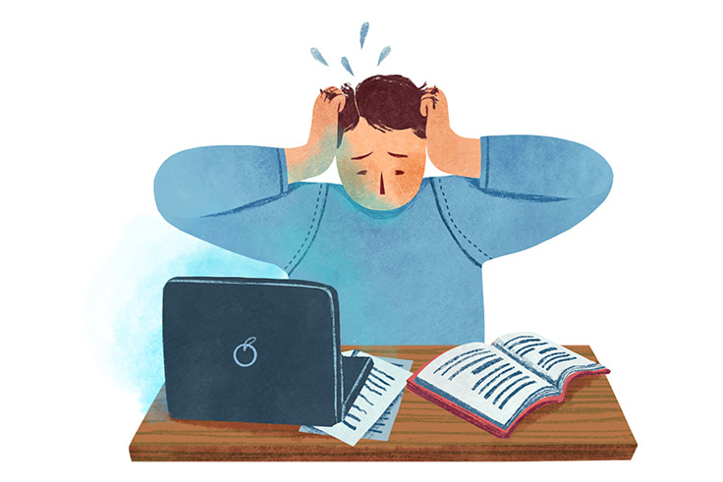
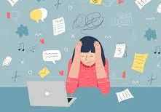

STRESS
.

Slide 19
STRESS
Stress can be defined as any type of change that causes physical, emotional, or mental strain. Stress is your body's response to anything that requires attention or action.
According to Rubenstein, “Stress is the reaction people have toward excessive pressures or other types of demand placed upon them. It arises when they worry that they can’t cope”.
It is the mental, emotional, and physiological responses caused by a stimulus that is either real or imaginary.
.
Notes:
Stress is how we react when we feel under pressure or threatened. It usually happens when we are in a situation that we don't feel we can manage or control.

Slide 20
Meaning of Stress
Stress is a part of Life
Stress can be Acute or Chronic
Stress can be Self-controlled
It provides stimulus for growth and change
It affects all dimensions of Life
It is a universal phenomenon
It is an individual experience
.
Notes:
Biological Factors
The study of the biological contributions to personality may be studied under three heads:
Heredity
Heredity refers to those factors that were determined at conception. Physical stature, facial attractiveness, sex, temperament, muscle composition and reflexes, energy level, and biological rhythms are characteristics that are considered to be inherent from one’s parents.
Brain
The second biological approach is to concentrate on the role that the brain plays in personality. The psychologists are unable to prove empirically the contribution of the human brain in influencing personality.
Cultural Factors
Among the factors that influence personality formation is the culture in which we are raised, early conditioning, norms prevailing within the family, friends and social groups and other miscellaneous experiences that impact us.
The culture largely determines attitudes towards independence, aggression, competition, cooperation and a host of other human responses
Family Factors
Whereas the culture generally prescribes and limits what a person can be taught, it is the family, and later the social group, which selects, interprets and dispenses the culture. Thus, the family probably has the most significant impact on early personality development.
A substantial amount of empirical evidence indicates that the overall home environment created by the parents, in addition to their direct influence, is critical to personality development.
Social Factors
There is increasing recognition given to the role of other relevant persons, groups and especially organisations, which greatly influence an individual’s personality. This is commonly called the socialization process.
Situational Factors
Human personality is also influenced by situational factors. The effect of the environment is quite strong. Knowledge, skill and language are obviously acquired and represent important modifications of behavior.

Slide 21
Factors causing Stress in Organization
Life Stressors
These are personal stressors that affect the individual. Some individuals may have economic obligations towards banks or family which causes stress. The basic stressors are:-
Retirement
Divorce
Loss of Job
Marriage
Personal injury
Death of a close family member
Addiction
Time Management, etc.

Slide 22
Factors causing Stress in Organization
Organizational Stressors
Physical Demand: They are dependent on the job setting. Physical environment factors such as poor office design and humidity can contribute to physical demand.
Task Demand: These are stressors linked to a particular type of job or work that causes stress to the performer, such as Meeting sales targets or call centre jobs.
Role Demand: The stress arises from the position in the organization or group. Sometimes an employee is not clear about his role and there are role conflicts which lead to stress.
Interpersonal Demand: They are associated with the attributes of the relationship of individuals of the organization. This includes leadership styles, personality style or pressure from the group, etc.

Slide 23
Factors causing Stress in Organization
Environmental Stressors
These are the stressors that are out of control of the individual They include the following:-
Political Uncertainty: An unstable political system gives stress to employees as there are unstable policies and laws.
Economic Uncertainties: If a country faces recession or slow growth then the employees face job insecurity which results into stress.
Technological Advancements: If the technology changes in the external environment, then the employees fear losing their jobs to machines, leading to stress.

Slide 24
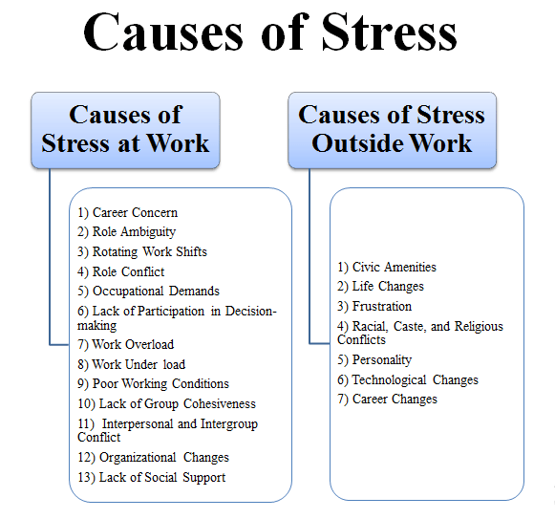
Causes of Stress

Slide 25
Types of Stress
Acute Stress
Episodic Acute Stress
Chronic Stress
Post Traumatic Stress

Slide 26

Acute Stress
Acute stress is the body’s response to a short-term demand or change. This type of stress can last anywhere from minutes, to hours, days, and even weeks. The duration depends on how long you’re exposed to an intense situation. Acute stress occurs when we need to fight off danger such as having a near-fatal experience or completing a marathon

Slide 27

Episodic Stress
Episodic acute stress is the body’s response to a single, isolated stressful event. These types of events include traffic accidents and other kinds of emergencies. They may also involve some kind of physical danger. Episodic or time-limited stress can be short or long-term. This depends on how you deal with it emotionally.

Slide 28
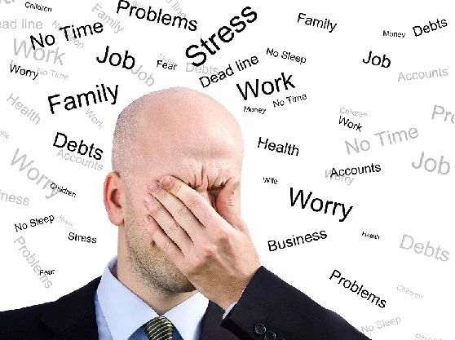
Chronic Stress
Chronic stress is when your body experiences low-grade demands and threats on daily basis. This may include things, such as traffic jams/delays, having an argument with someone close to you. Working multiple jobs while trying to get by in life can also cause chronic stress. It’s often caused by the pressure you put on yourself to meet all of your own expectations.

Slide 29
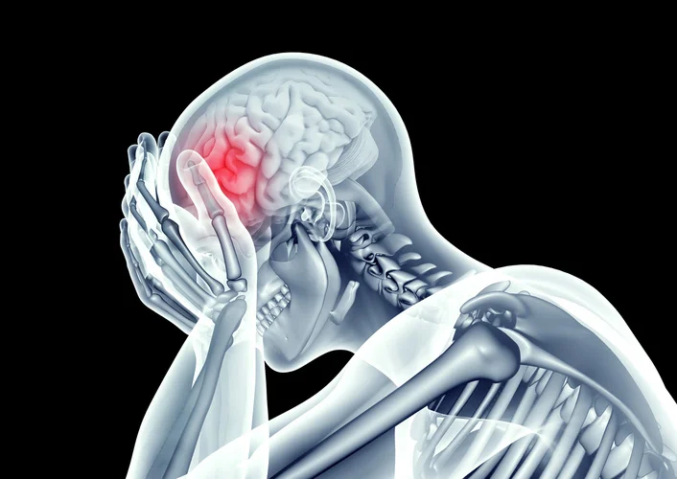
Post Traumatic Stress
Post-traumatic stress disorder is a mental health condition. It is one of the most dangerous types of stress. It can develop after the experience or witnessing of traumatic events. Traumatic events are war, violent personal or natural disasters.

Slide 30
Daily Quiz
The combination of characteristics or qualities that form an individual’s distinctive character” is the definition of ____
a) Personality
b) Motivation
c) Attitude
d) Behaviour
The family condition and impact of the parents is the main base for the personality of a person. Later it might change by ________
a) thinking
b) external influences
c) own ability
d) learning experiences

Slide 31
Daily Quiz
Every individual is ________ by their personality.
a) Intellectual
b) Specific
c) Unique
d) Systematic
Outgoing, talkative, social are part of __________ Personality Trait as per big 5 personality trait
a) Friendly
b) Openness to experience
c) Introversion
d) Extroversion

Slide 32
Stress Management
Stress management is the technique to relieve stress by adopting a healthy lifestyle, work-life balance, time management, and minimizing the stress causes.
Notes:
Nowadays, stress is normal for every human being. Stress is generally, the reaction of the human body to a situation where we feel we can’t manage or control it. Stress can be referred to as any type of change in humans due to psychological, emotional or physical strain.

Slide 33
Stress Management Strategies/techniques
Mindfulness Meditation
Exercise/Yoga
Imagery
Time-Management
Self-Care
Maintain a ‘Stress Diary’
Tune in to Music
Reading Books
Socializing with Friends and Family
Get a Hobby
Consult a Psychologist/Counselor
Keep a Positive mindset

Slide 34
Conflict
Conflict is serious disagreement and argument about something important. If two people or groups are in conflict, they have had a serious disagreement or argument and have not yet reached agreement.
According to S. R. Robbins defines conflict as “a process in which an effort is purposefully made by a person or unit to block another that result in frustrating the attainment of others goals or furthering of his or her interests.”
Conflict can be defined as a difference that exists between needs, values, and interests of individuals or groups in an organization.
Notes:
an open clash between two opposing groups

Slide 35
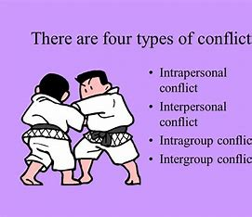
Types/Levels of Conflict

Slide 36

Intrapersonal conflict
Intrapersonal conflict occurs within an individual. The experience takes place in the person’s mind. Hence, it is a type of conflict that is psychological involving the individual’s thoughts, values, principles and emotions.
It might be a role conflict where a worker might have to choose between dinner with clients or dinner with family.

Slide 37

Interpersonal Conflict
Interpersonal conflict refers to a conflict between two individuals.
This occurs typically due to how people are different from one another. We have varied personalities which usually results to incompatible choices and opinions.

Slide 38
Intragroup Conflict
Intragroup Conflict is a type of conflict that happens among individuals within a team.
The incompatibilities and misunderstandings among these individuals lead to an intragroup conflict. It is arises from interpersonal disagreements or differences in views and ideas

Slide 39
Intergroup Conflict
Intergroup Conflict takes place when a misunderstanding arises among different teams within an organization. For instance, the sales department of an organization can come in conflict with the customer support department. This is due to the varied sets of goals and interests of these different groups. In addition, competition also contributes for intergroup conflict to arise. There are other factors which fuel this type of conflict.

Slide 40
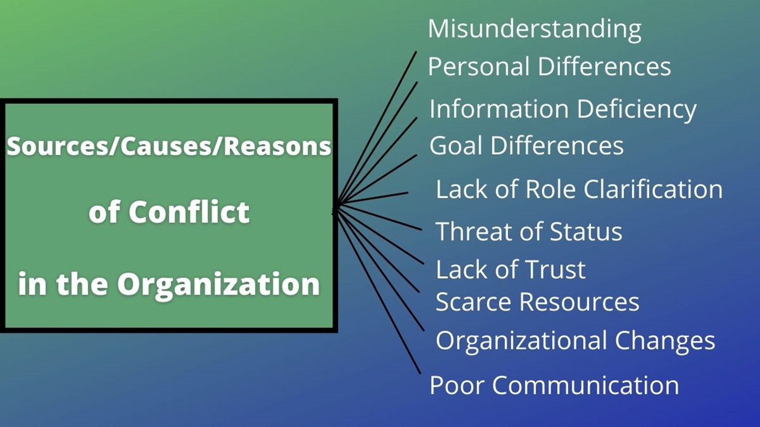
Causes of Conflict
.

Slide 41
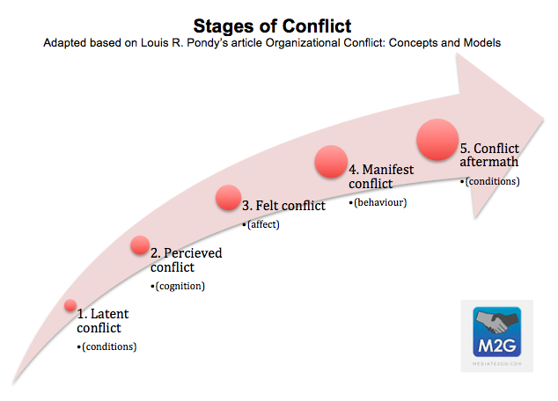
Stages of Conflict
.
Notes:
Latent Stage: Participants are not yet aware of conflict.
Perceived Stage: Participants are aware a conflict exists.
Felt Stage: Stress and anxiety.
Manifest Stage: Conflict is open and can be observed.
Aftermath Stage: Outcome of conflict, resolution or dissolution.

Slide 42
Latent Stage
.
.
In the “Latent Stage,” the first stage in the five stages of conflict, people may be in conflict without being aware that they are in conflict.
An example of this could be that a server at a restaurant may have inputted an order incorrectly and the food being made for a table is the wrong food. The manager and table do not know this yet and conflict has not arisen yet.

Slide 43
Perceived Stage
.
The “Perceived Stage” is when the people involved in a conflict become fully aware that there is a conflict, so the table has now been made aware and complained to management. Management will now go over to speak with the employee about it.

Slide 44
Felt Stage
.
During the “Felt Stage” stress and anxiety are felt by one or more of the participants due to the conflict, the manager does not enjoy causing conflict and the employee does not enjoy being under scrutiny.

Slide 45
Manifest Stage
.
“Manifest Stage,” during which the conflict can be observed. The Manifest Stage can take a number of shapes including: e-mails, phone calls, phone messages, face-to-face meetings, or any situation in which the conflict could be observed. When the manager pulls the employee aside to speak with him or her, others perceive the conflict and it has manifested.

Slide 46
Aftermath Stage
.
The final stage is the “Aftermath Stage,” which takes place when there is some outcome of the conflict, such as a resolution to, or dissolution of, the problem. When the manager corrects the mistake with the customer and takes appropriate steps to ensure the server is more careful in the future.

Slide 47

Conflict management
Conflict management refers to the way that you handle disagreements. On any given day, you may have to deal with a dispute between you and another individual, your family members, or fellow employees.

Slide 48
Conflict management styles
Accommodating-
An accommodating mode of conflict management tends to be high in cooperation but low in confidence. When you use this style, you resolve the disagreement by sacrificing your own needs and desires for those of the other party.
This management style might benefit your work when conflicts are small and you need to move on quickly. At home, this style works when your relationship with your roommate, partner, or child is more important than being right

Slide 49
Conflict management styles
Avoiding-
When avoiding, you try to excuse or bypass a conflict. This style of managing conflicts is low in assertiveness and cooperativeness. Avoidance is unproductive for handling most disputes because it may leave the other party feeling like you don't care. Also, if left unresolved, some conflicts become much more troublesome.
However, an avoiding management style works in situations where:
You need time to think through a disagreement.
You have more pressing problems to deal with first.
The risks of confronting a problem outweigh the benefits.

Slide 50
Conflict management styles
Collaborating-
A collaborating conflict management style demands a high level of cooperation from all parties involved. Individuals in a dispute come together to find a respectful resolution that benefits everyone..

Slide 51
Conflict management styles
Competing-
When you use a competitive conflict management style (sometimes called 'forcing'), you put your own needs and desires over those of others. This style is high in assertiveness and low in cooperation. In other words, it's the opposite of accommodating.

Slide 52
Conflict management styles
Compromising-
Compromising demands moderate confidence and cooperation from all parties involved. With this type of resolution, everyone gets something they want or need. This style of managing conflict works well when time is limited. Because of time constraints, compromising isn't always as creative as collaborating, and some parties may come away less satisfied than others

Slide 53
Daily Quiz
_____ theory argues that behaviour is a function of its consequences.
Equity
Reinforcement
Goal-setting
Expectancy
_____ focuses on core job attributes, critical psychological states, and expected outcomes.
a. The equity model
b. The expectancy model
c. The two-factor model
d. The job characteristics model

Slide 54
Daily Quiz
Which is NOT a dimension in Maslow's Hierarchy of Needs?
Ego
Physiological
Safety
Esteem
_____ theory argues that behaviour is a function of its consequences.
Equity
Reinforcement
Goal-setting
Expectancy
Who has given the ERG theory of motivation?
Clayton Alderfer
David McClelland
Victor Vroom
Frederick Herzberg
Douglas McGregor

Slide 55
Youtube Video Links
Youtube/other Video Links
https://www.youtube.com/watch?v=R3aonvQQOt8
https://www.youtube.com/watch?v=tCEuJxJH4qA
https://www.youtube.com/watch?v=E8s-IsB2p5c

Slide 56
Weekly Assignment
Discuss the different Ego states in Transactional Analysis.
Explain Johari window as a tool for interpersonal effectiveness.
Write a descriptive note on the process of Motivation.
State the determinants of Personality.
Explain the process of Attitude formation.

Slide 57
MCQ s
1. Major determinants of personality
Biological
Situation
Both (A) and (B)
None of the above
2. Mismatch between personality and organization may lead(s) to
Confusion and chaos
Loss of interest by members in organization
Low morale and job satisfaction
All of the above

Slide 58
MCQ s
3. __ in the year 1954 proposed the need Hierarchy theory of Motivation.
Abraham Harold Maslow
Herzberg
Adam’s Equity Theory
None
4. According to ___ work effort in an organization is directed towards behaviours that people believe will lead to desired outcomes.
Expectancy Theory
Self Determination Theory
Maslow Theory
None

Slide 59
MCQ s
5. Which of the following would be classified by Herzberg as a hygiene factor?
Promotion
Personal growth
Achievement
Company policy
Responsibility
6. Which among the following is correct expansion of ‘ERG’ in ERG theory of motivation?
E – Existence, R – Religion, G – Growth
E – Experience, R – Related, G – Growth
E – Existence, R – Related, G – Growth
E – Existence, R – Requirement, G – Growth
E – Effectiveness, R – Related, G – Growth

Slide 60
MCQ s
7. _____ is the set of forces that energize, direct, and sustain behavior.
a. Motivation
b. Expectancy
c. Empowerment
d. Socialization
8. Maslow’s hierarchy of needs includes all of the following categories EXCEPT _____.
a. safety
b. growth
c. physiological
d. self actualization

Slide 61
Expected Questions for University Exam
Define Motivation. Explain traditional theories of motivation.
Discuss how many factors are there in Herzberg theory of motivation.
Explain each level in Maslow’s need theory.
State and explain any one contemporary theory of Motivation.
Enlist the factors in Expectancy theory.
Discuss Equity theory.
Explain the different types of transactions and ego states in transactional analysis.
Explain the different types of Attitudes.
Explain the concept of Attitude and its formation in detail.
Define Personality.
State the determinants of Personality.
Differentiate between Type A and Type B personality.
Discuss the concept of Johari Window.

Slide 62
Recap of the Unit
This topic tells us about the Two words attitude and personality are used interchangeably but there is a key difference between these two words. Personality is basically a combination of quality or the characteristic of any individual. On other hands, attitude refers to a way of thinking, belief or an emotion of an individual.
Motivation is essentially the underlying drive of individuals to accomplish tasks and goals. Many factors can influence employee motivation, including organizational structure, integrity of company operations, and company culture.

Slide 63
References
1.Koontz Harold, Weihrich Heinz& Mark V. Cannice – Essentials of management (Tata McGraw Hill, 11thEdition,2020)
2. Robbins Stephen P& Judge Timothy A. ―Organizational Behaviour (Pearson)
3. Robbins &Coulter :Management (Pearson, 14th Edition, 2019)
4. Pareek Udai :Understanding Organizational Behaviour, (Oxford University Press, 4th Edition, 2016)
5.Luthans Fred : Organizational Behaviour, (McGraw Hill International Edition, 12th Edition,2013)
6. Prasad L. M. : Principles and Practices of Management, (SultanChand& Sons, 9th edition,2016)

